Slide 1
Mounted PNT & COM
MAY, 2020

Slide 2
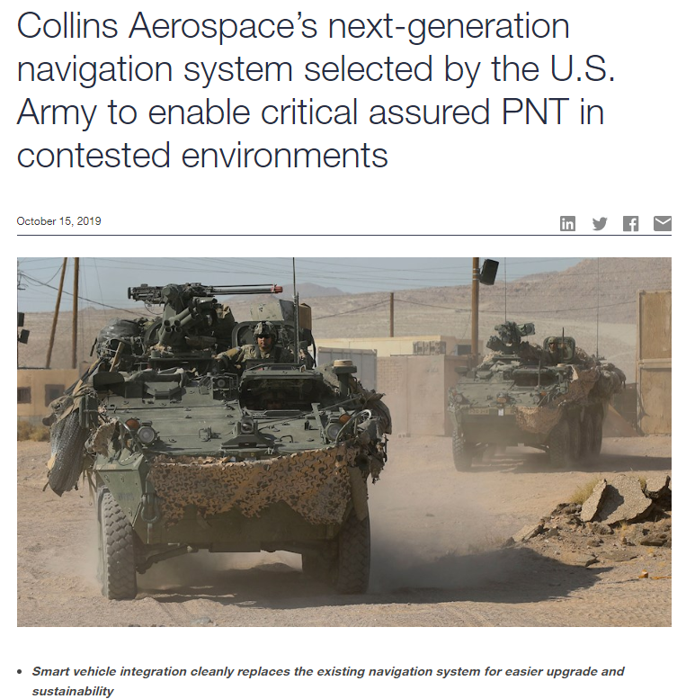
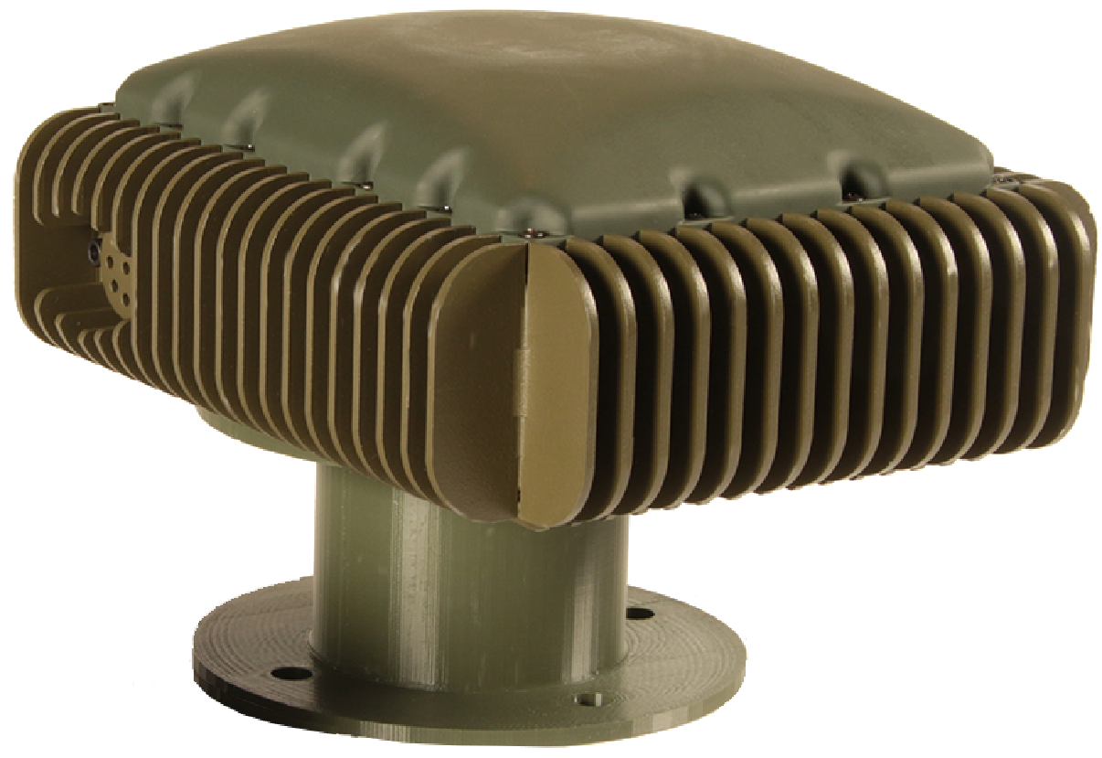
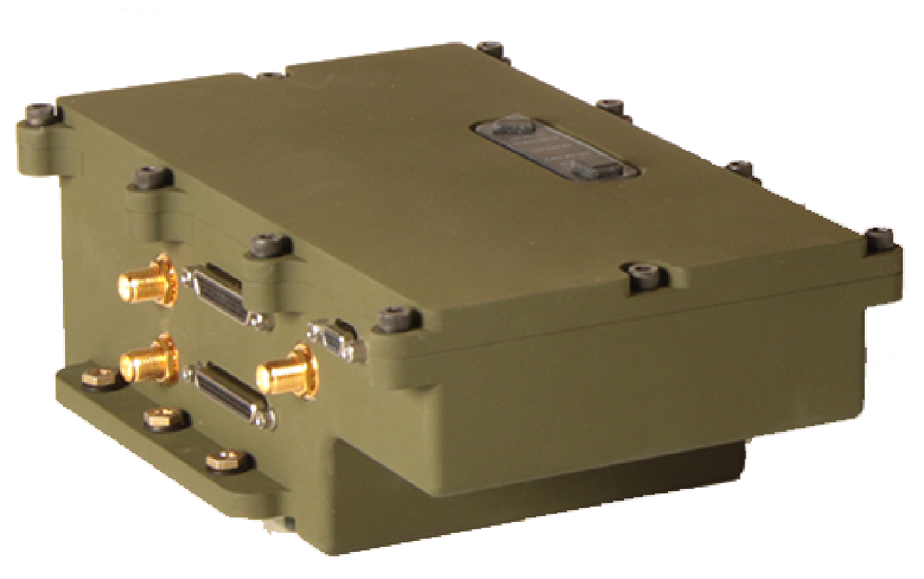
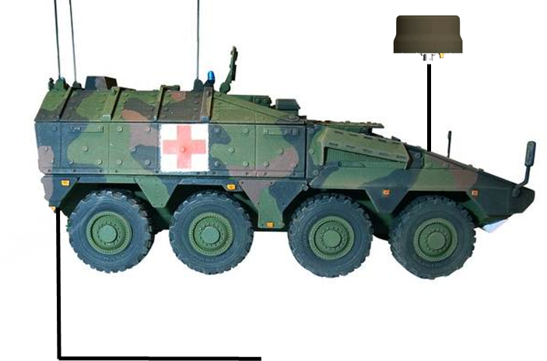
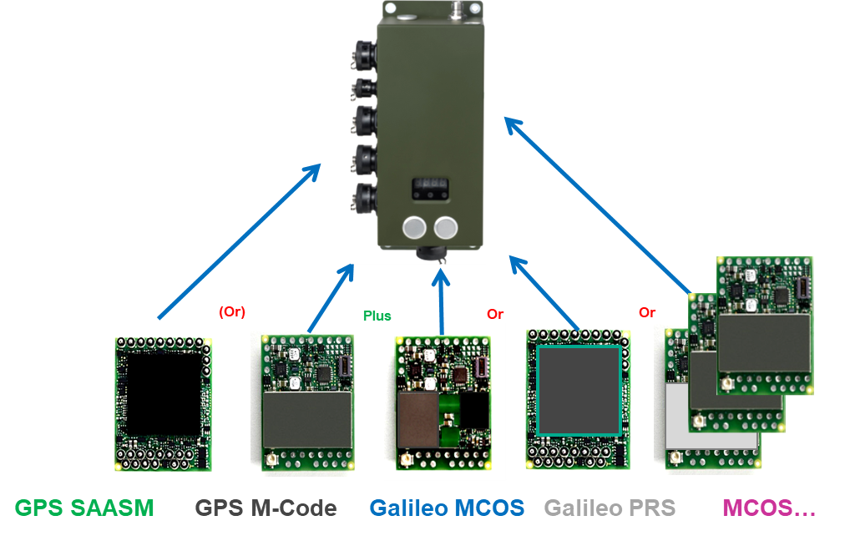
ASSURED PNT TECHNOLOGIES & SOLUTIONS
https://www.utc.com/en/news/CAS/2019/10/15/collins-aerospaces-next-generation-navigation-system-selected-by-the-u-s-army-t
Mounted Assured Positioning, Navigation, and Timing (APNT) System (MAPS GEN II) APNT for US Army
NavHub-100 navigation system with MPE-M and Digital GPS Anti-jam Receiver-100 (DIGAR-100)
The NavHub-100 is the navigational solution that generates and distributes APNT information to all systems onboard the platform through one device
Internationally NAVHUB-200 (224-2200-002) compact solution provides M-GNSS ALTNAV A-PNT
NavHub-200 (224-2200-002)
One LRU, Two GNSS Cards - Protected Military GPS (SAASM/M-Code), Multi-Constellation GNSS (OS/PRS)
Multiple Interfaces (RS232/422, CAN, USB, Ethernet) and External IMU interface
Collins Aerospace Proprietary Information. This document contains no export controlled technical data
12

Slide 3
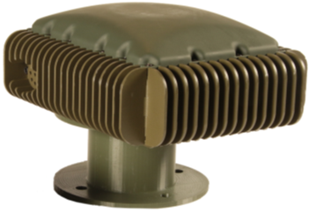
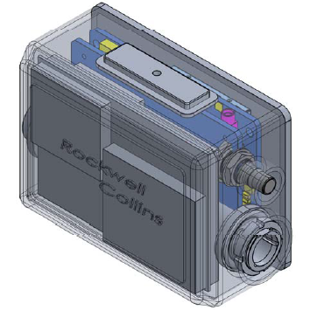
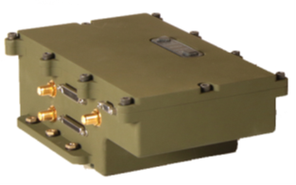
Multi-Layered PNT Solution ROADMAP
Collins scalable, open system A-PNT solutions are designed from the ground up with M-Code, which provide the ideal foundation for multi-layered PNT solutions
Maximum GPS performance and security
Advanced GPS situational awareness via MGUE assurance indicators and alarms
Resiliency and Software Assurance Modification (RSAM) alarms
GPS + Non-GPS
Fusion
PNT Distribution, GPS
Only
PNT Distribution, GPS
Only
PNT Distribution, GPS + Non-GPS Fusion
Dismounted Equip.
Threat Condition 1
Threat Conditions 1-2
Threat Conditions 1-5

Slide 4
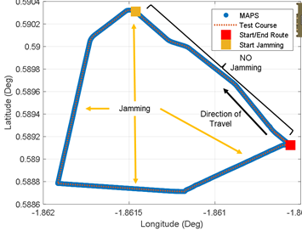
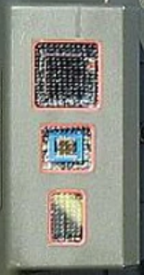
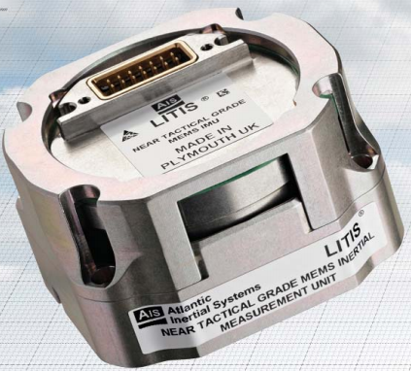
COLLINS MAPS GEN II
PROVEN PERFORMANCE AGAINST MULTIPLE THREATS
Latitude
Vehicle Velocity Source
(Open architecture supports multiple options to minimize platform integration impact)
Longitude
The Collins MAPS Gen II system provides Assured PNT in GPS-Available and GPS-Contested environments, as demonstrated by PNTAX 2019 test results

Slide 5
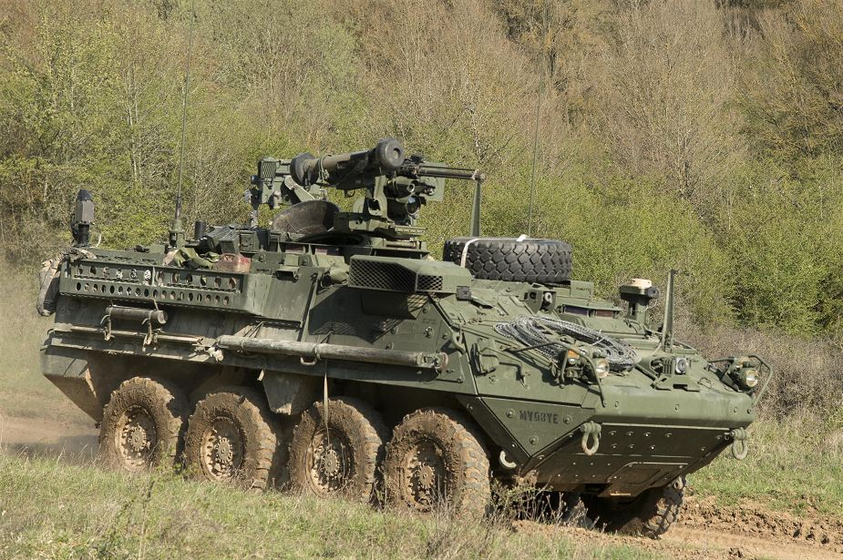
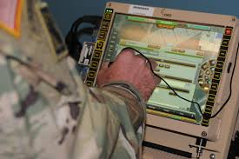
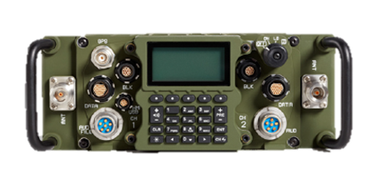
ALL-DOMAIN APPLICATION OF ASSURED PNT & COM
MAPS GEN II has been successfully integrated with the PRC-162 Manpack radio by the U.S. Army
MAPS Gen II initialized PRC-162 for secure waveform communications
PRC-162 communicated assured platform position to another PRC-162
Command & Control systems (FBCB2/MFoC/JBCP) displayed real-time assured platform position
Key Benefits to the Government
Reduces integration risk for two of the Army's highest priority programs
Demonstrates real-world application of Assured PNT
Supports Multi-Domain Operation (MDO) 2.0 by ‘28
MAPS Gen II
(NavHub-100
and MSAS-100)
Assured PNT over Secure Waveform
PRC-162
Command & Control Systems
Collins PNT and Comm expertise ensures secure communication and real-time Command & Control in a GPS-threatened or denied Environment

Slide 6
AN/PRC-162(V)1 PROGRESS UPDATE
Demonstrated reliable IW interoperability with OEM radios
JITC testing completed for all SATCOM waveforms
Extensive over the air testing of IW via operational satellite channels
On-the-Move and At-the-Pause without external PAs
Lab and Field Demonstrations of Battery Life – Met or exceeded 8 hour Threshold Requirement for all waveform configurations
MUOS IATT received and MUOS successfully demonstrated at several field events
Continued positive feedback from Soldiers

Slide 7
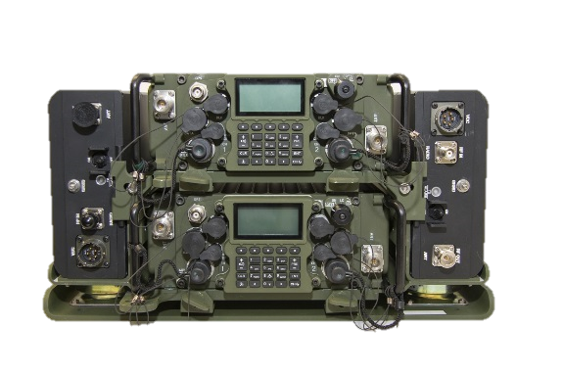
PRC-162 KEY FEATURES
Fully integrated 2 channel radio
Simultaneous operation on both channels
Seamless/integrated cross-banding or retransmission of voice and data
Software Defined Radio (SCA 2.2.2)
Banded 30-88, 118-137, 225-450, 1250-1450, 1755-1850 MHz
SRW, SINCGARS, DAMA, IW, MUOS, VULOS, HaveQuick I/II, WREN NB, WREN TSM
Man portable, vehicular, and transportable kits available
Embedded SAASM GPS (Future M-Code upgrade)
Data interfaces: Ethernet, IP-over-USB, Serial RS232/RS422
Output Power / Ch: 20W, 50W with Vehicular PA
Power: Standard x90 series batteries, 28VDC vehicle power
‹#›
Notes:
Radio will be backwards compatible with TSM...they believed that they needed TSM X for fires for a higher level of security
Brits have less than 80K Soldiers...who cares what they want (we are to ensure we don’t go down the wrong road)
USAF does not use Link16...why is the Army marching in this direction?
Is there any licensing costs associated with new software updates?
Asked if they care about releasability...don’t know what that means...creating an Enterprise Service with Coalition Partners
Waveform use depends on what the S6 is comfortable with on what is used
What did the PM give as a date for M-Code upgrade for SAASM? Year and a half for Collins -- Soldier TCM has pushed 2025 FY

Slide 8
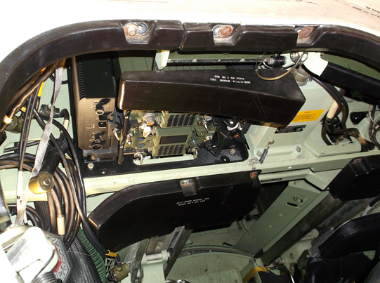
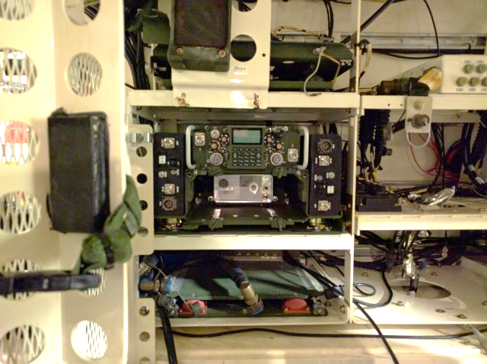
On the move
IDEAL FOR VEHICULAR APPLICATIONS
Bradley Fighting Vehicle – Commander’s Position
HMMWV
Stryker - ICV

Slide 9
SO WHAT MAKES US DIFFERENT?
A FEW KEY DISCRIMINATORS
20W peak output power: All Bands, All Waveforms
Competitor is limited to 10W for most waveforms
In most cases, eliminates need for 50W vehicular PA
20W demonstrated SINCGARS range of 40km+ G2G, and 160km+ G2A
R/T orientation allows for decreased depth in vehicle installations
Essential for space constrained vehicles
External PA agnostic – no proprietary interface
Enables flexible PA solutions through a variety of vendors
Extremely reliable hardware; by-product of our airborne heritage

Slide 10
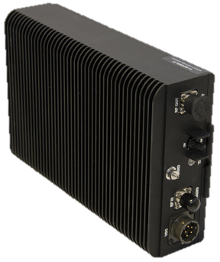
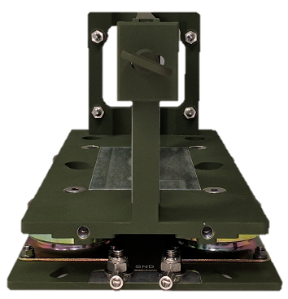
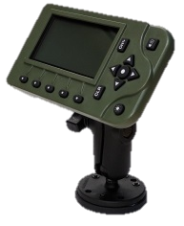
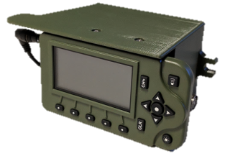
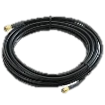
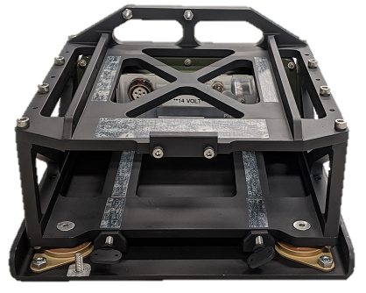
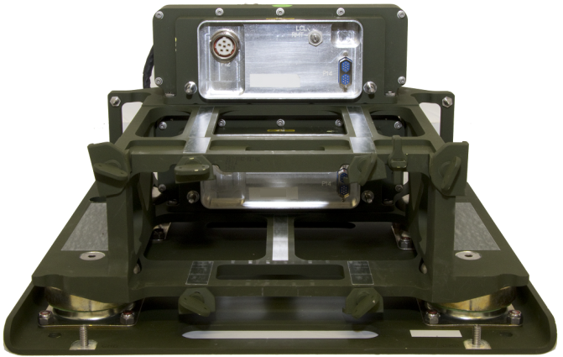
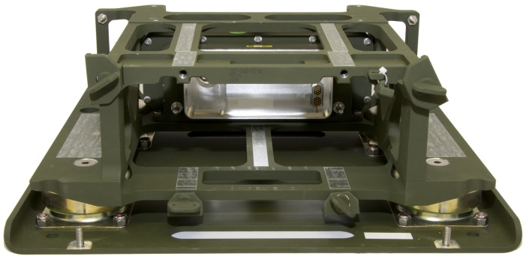
PRC-162 VEHICULAR ANCILLARIES
Rockwell Collins provides a family of vehicular ancillaries and installation kits supporting the PRC-162 advanced two channel Manpack radio. Our solutions provide a flexible and scalable architecture, meeting varying customer needs.
Installation Kits
Mission Modules & Power Amplifiers
Dual PA Mount
Remote HMI
4-Channel DVM
2-Channel SFF
2-Channel SVM

Slide 11
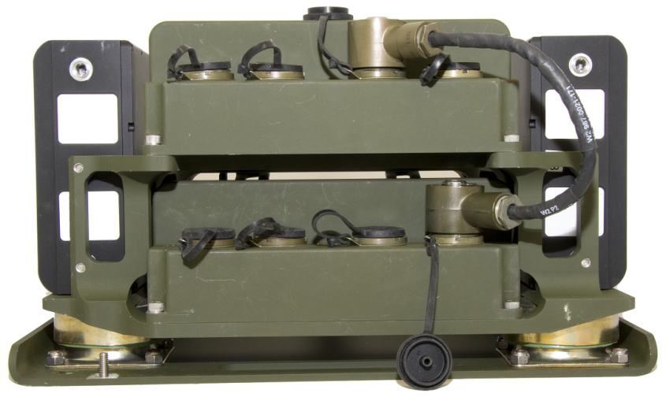
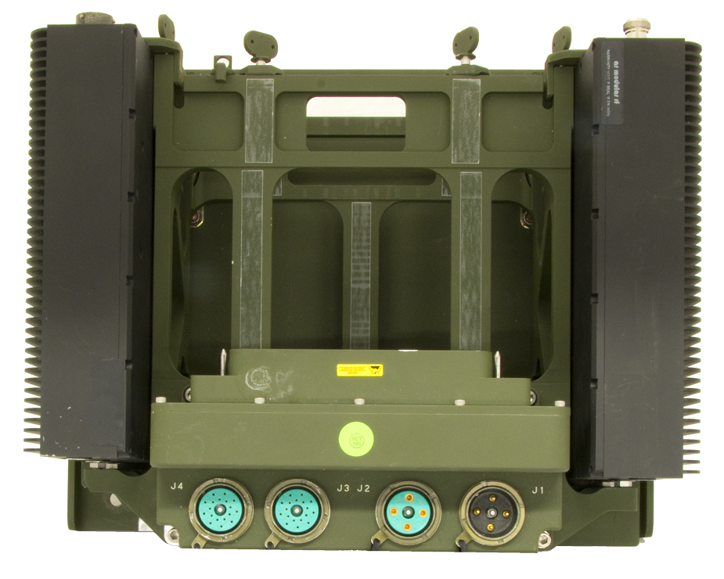
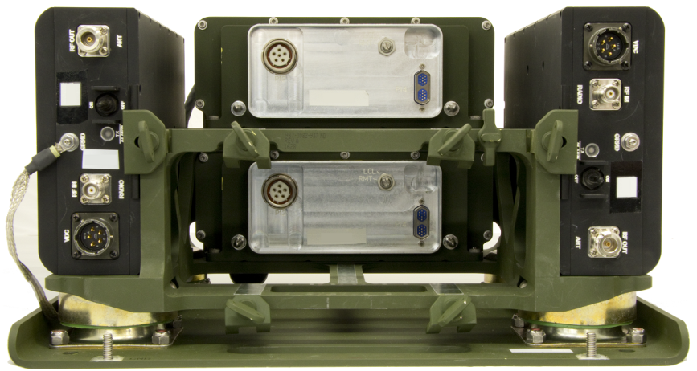
VEHICLE MOUNT INTERFACES
Single/Dual Radio Vehicle Mount Interfaces
Intercom Audio(J3/J4)
Fixed Level Audio - Programmable within radio to support multiple Loudspeakers and Intercom Systems (LS-671, AN/VIC-3, AN/VIC-5)
Power Out (J2)
Daisy chained unfiltered 28VDC vehicle power. Used to power 2nd radio adapter or Intercom System
Power In (J1)
28VDC Power Input from Vehicle or 1st radio adapter
RMT/LCL Switch
RMT: Remotely powered up based on Intercom System Power State.
LCL: Locally powered based on RT power knob state.

Slide 12
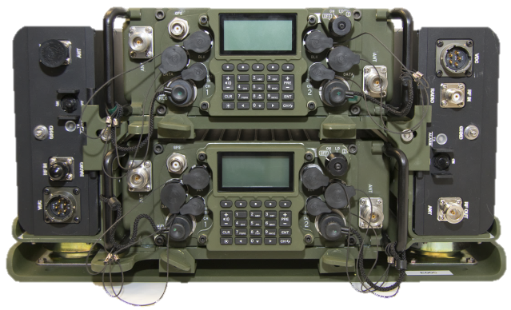
MISSION MODULE GROWTH SLOT
As a substitute for the HPA, the slot can support a Mission Module
Potential Mission Module Concepts:
Advanced Cosite/Tracking Filter
3rd Party Radio/Waveform Channel
TSM Type 3 with 20W Amplifier
WaveRelay Type 3 with 20W Amplifier
Iridium Satellite Communication
4G Cellular w/WiFi Access Point
EW Detection Module
A-PNT Module
Mission Computer with Display Output
Tactical Router
In-Country Unique Functionality
Radio Support of Mission Module
Integrated HMI Status menu for Mission Module detection and health status
Connect Radio to Mission Module via single communication cable
For Radio/Waveform MM’s, Radio HMI can also serve as control/status head

