Slide 1

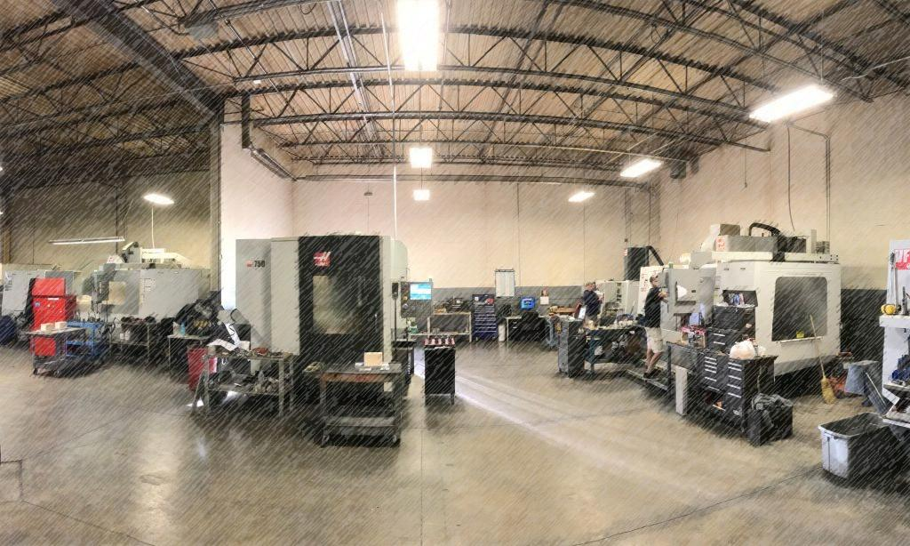
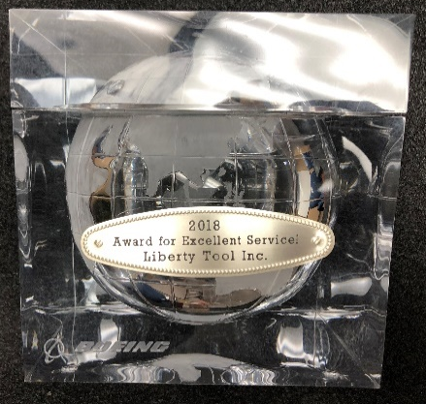
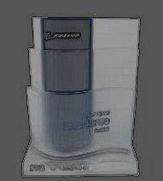



Your Tooling Solutions
Liberty Tool, Inc. has been in business in the Metro Detroit area since 1995. Employing over 25 skilled tradesmen and operating 24 hours per day. We can support all facets of your manufacturing needs. From concept to completion, our skilled team can meet all your design, build and inspection needs.
Utilizing our 30,000 square foot climate controlled facility we can support tooling and part production large and small. Our ERP management software insures efficiency in all of our operations.
We stand out from the crowd with competitive pricing, on time delivery, and high quality standards. We are looking forward to supporting all of your needs building a relationship you can depend on.
Boeing Excellence Awards

Slide 2
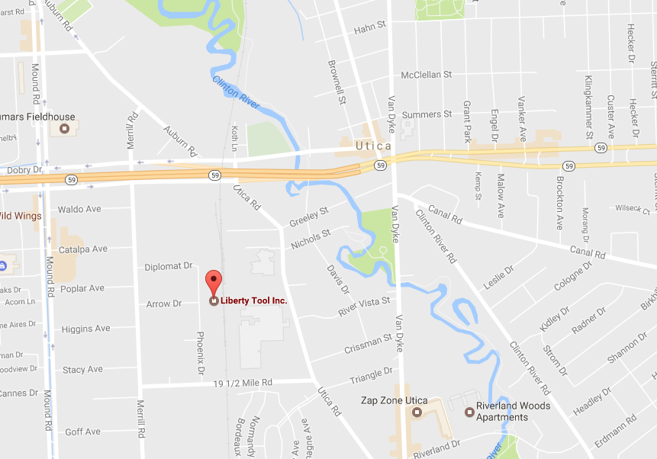
Phone (586) 726-2449
Fax (586) 726-1377
Corporate Address:
44404 Phoenix Dr.
Sterling Heights, MI 48314
USA
General Correspondence
smaier@liberty-tool.com
Sales
chris@liberty-tool.com
Program Management
rmcnaughton@liberty-tool.com
Estimation - Department
chris@liberty-tool.com
quotes@liberty-tool.com
Engineering
zcarrington@liberty-tool.com
Quality
rhoy@liberty-tool.com
Accounting
smaier@libert-tool.com

Slide 3
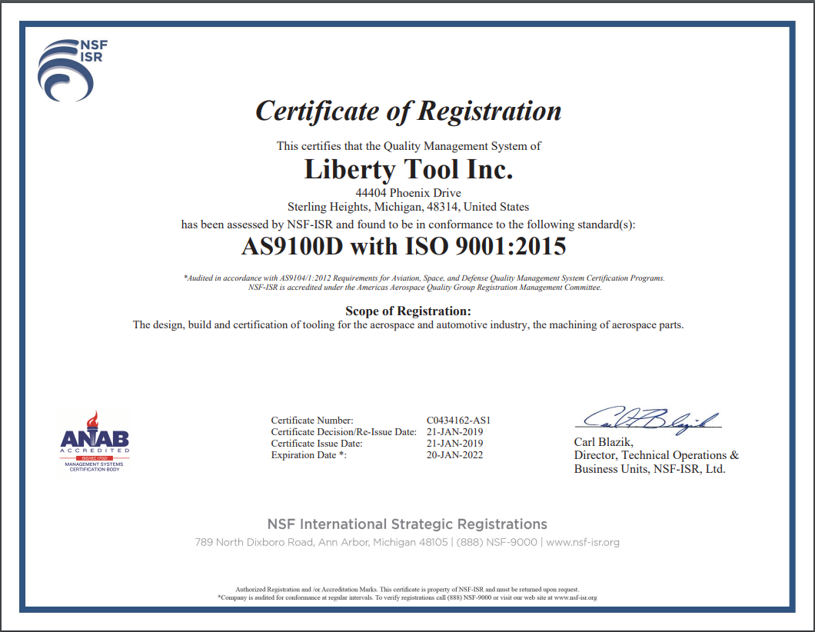
AS9100D
ISO 9001:2008
ITAR Registered

Slide 4
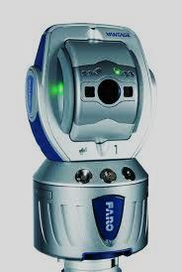
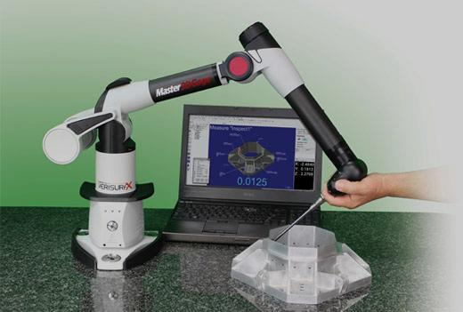
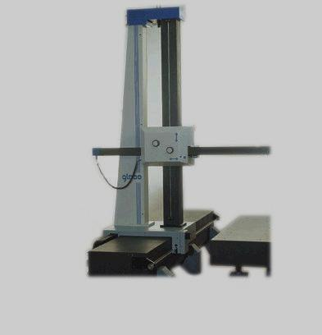
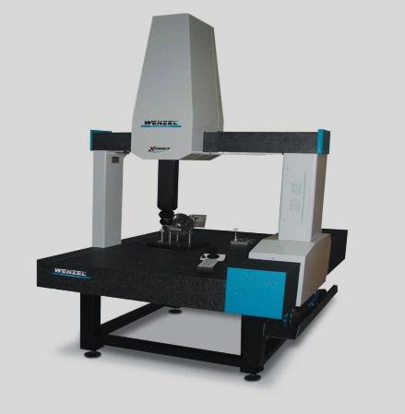


“A precision product, on time that exceeds customer expectations”
We are looking forward to supporting all of your needs building a relationship you can depend on.
Software Capabilities for quality:
• Verisurf with Native Catia Import
• MasterCam
• OpenDmis
• Capps6
• Rhino5
Our facilites include ...
• All laboratory measuring equipment traceable to National/International Standards(NIST/NPL)
• 24 Hour Temperature-Controlled and Monitored Inspection Facility.
Equipment Capabilities for quality:
• 1 Faro Laser Tracker
• 1 Portable Arm CMM: Master3D Gage 1.2 m (4 ft) Volume
• 1 CMM: Wenzel LH87 32" x 27" x 39" Envelope
• 1 CMM: POLI-GLOBO 1500 Horizontal - 120" x 60" x 60" Envelope
• 1 Rockwell Tester and various hand-held measuring devices

Slide 5
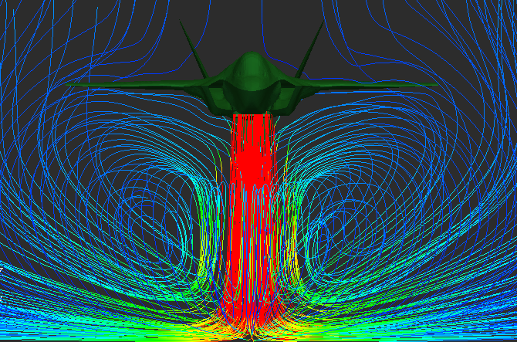
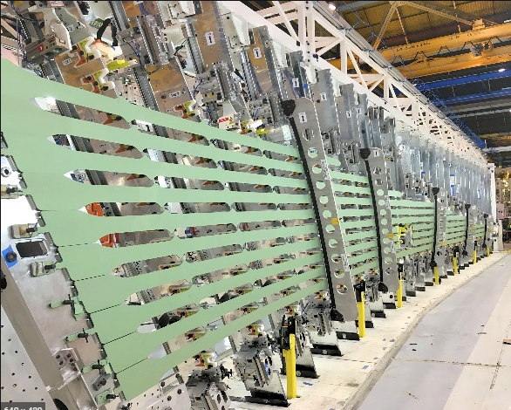


Our skilled design team is ready and able to champion your project from concept to completion. Our lengthy history in design still has decade old projects that are still in service today. They include but are not limited to manufacturing tools from automotive checking fixtures to aircraft tooling, as well as automated manufacturing and inspection services. You can count on our team at Liberty Tool to continually meet and exceed your expectations.
Our design team has the ability to provide support through out all stages of the design process. From initial conceptual beginnings, to in depth design we utilize both Catia and Unigraphics to supply a state of the art design. Our skilled design team works closely with our customers through out the design process insuring all of the expectations from our valued customers are met or exceeded.

Slide 6
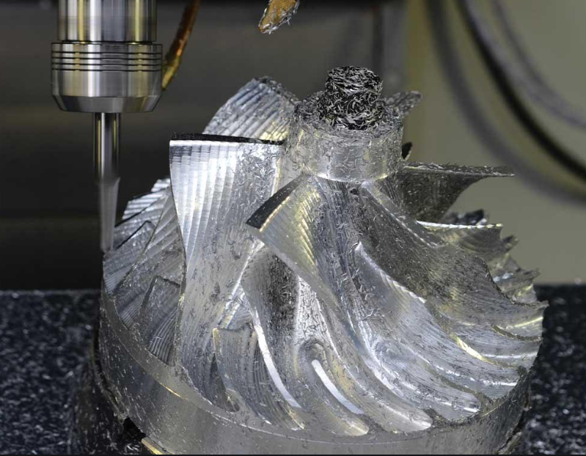
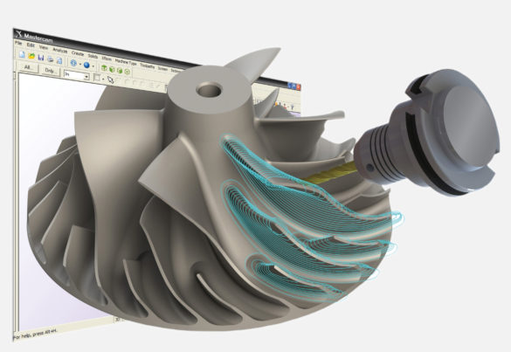
The Liberty Tool manufacturing team utilizes the latest Mastercam technology to efficiently manufacture tooling from a large variety of materials. Our skilled programming department and machinists utilize decades of experience to insure the highest quality components are manufactured to the industries most stringent tolerances.

Slide 7
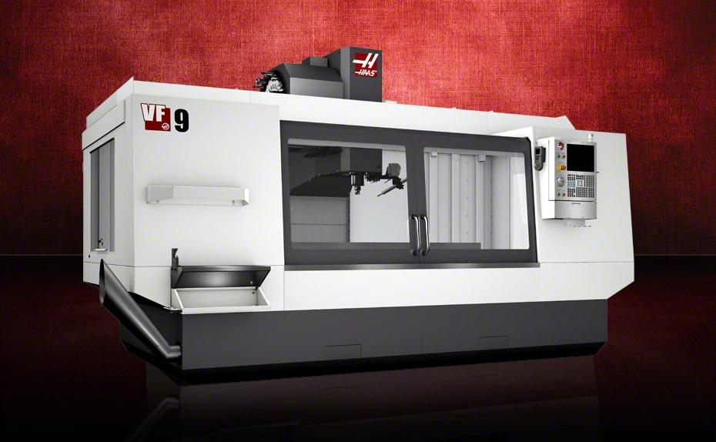
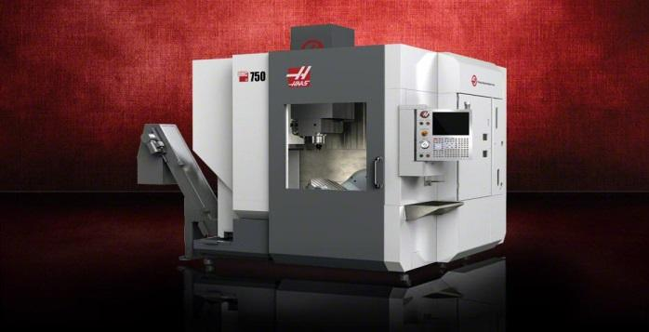
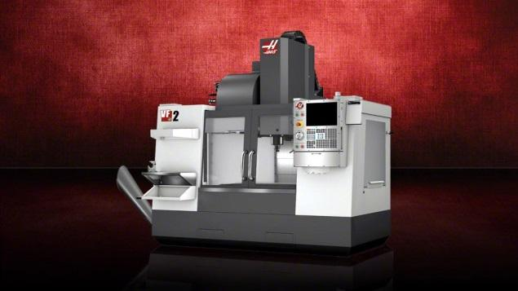
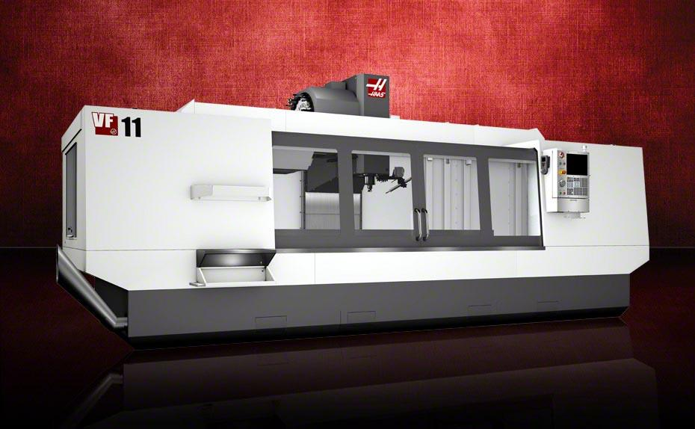
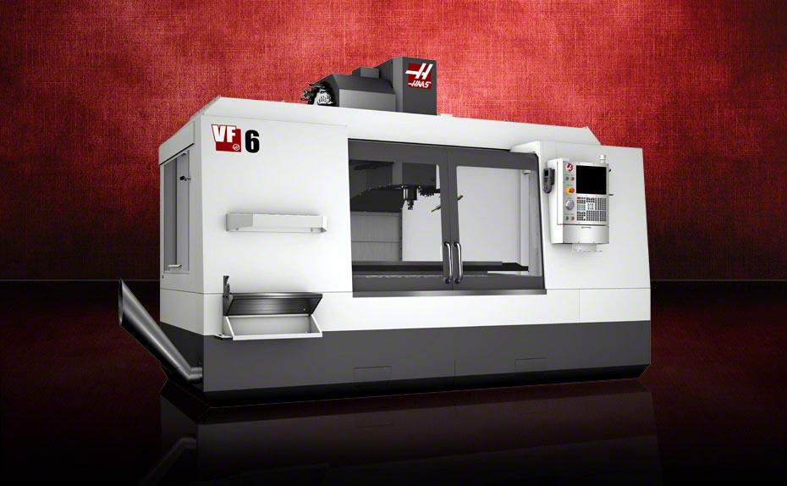
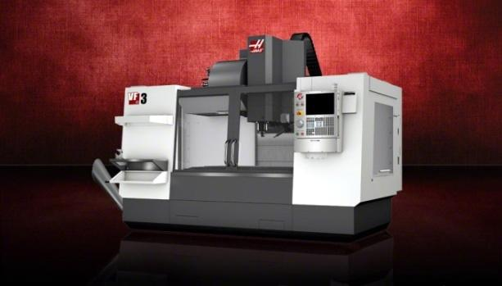
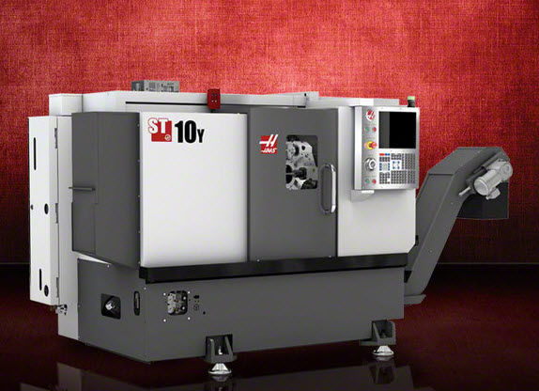
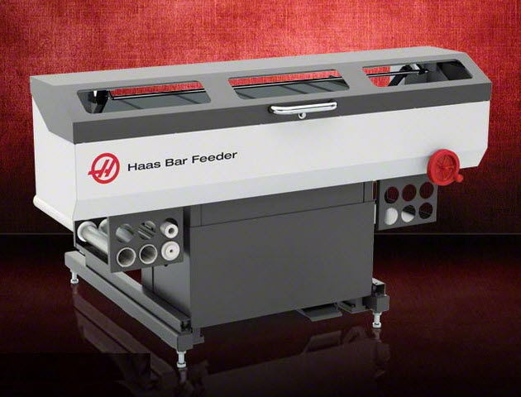
Our machining capabilities utilize high speed machining allowing us to stay on the cutting edge of technology. Coupled with our multiple CNC programming stations operated by our skilled tradesman at the helm this equipment allows efficient thorough put both in production runs as well as single parts.
No matter the complexity of your tooling or the tolerance requirement's, Liberty tool is ready to meet and exceed your expectations.
Manual Machinery:
• 12 Vertical Mills with read outs
• 3 Surface Grinders: Boyer Schultz
• 1 Wet Grinder: Brown and Sharpe
• 2 Welders: MIG & TIG
• 4 Vertical cut off saws
• 1 Horizontal cut off saw
Our facilites include ...
• 24 Hour Temperature-Controlled Manufacturing Facility
5 Axis Machining Center :
• 1 CNC Machine: HAAS VR-11 - 120 x 40 x 30
• 2 CNC Machine: HAAS UMC 750 - 30 x 20 x 20
3 Axis Machining Centers :
• 2 CNC Machine: HAAS VF9 - 84 x 40 x 30
• 1 CNC Machine: HAAS VF6 - 64 x 32 x 30
• 1 CNC Machine: HAAS VF3 - 40 x 20 x 25
• 2 CNC Machine: HAAS VF2 - 30 x 20 x 20
• 1 CNC Machine: HAAS 10Y lathe with live
Tooling and automatic bar feeder
3 Axis Fabrication Centers :
• 1 CNC Plasma Cutter: Torch-Mate - 48 x 72

Slide 8
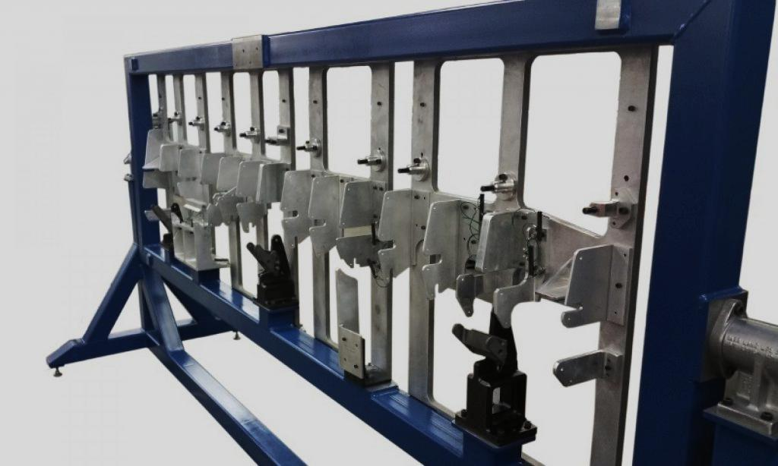
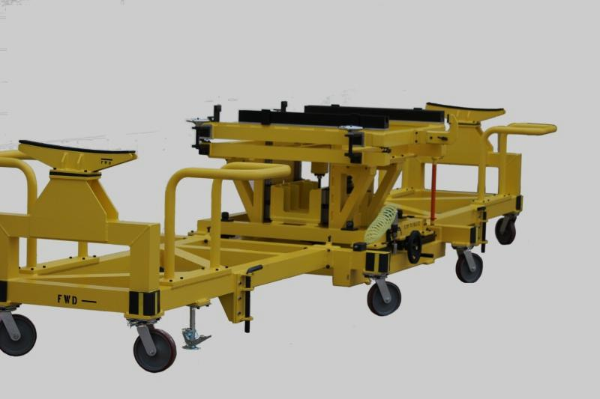
Assembly Fixtures
Transfer Carts

Slide 9
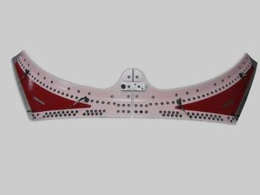
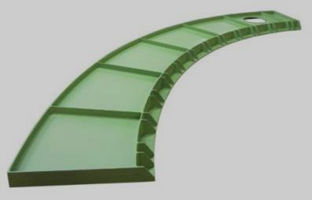
Drill Plates
Large Machining

Slide 10
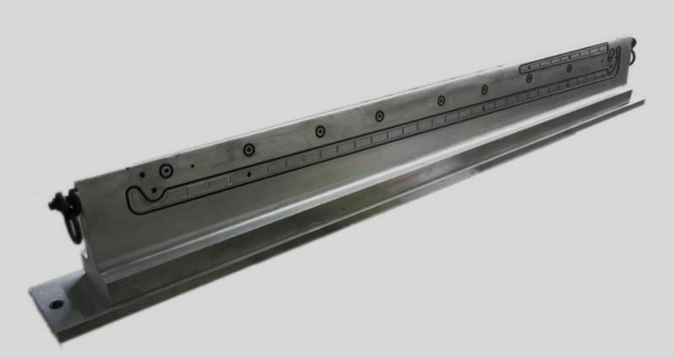
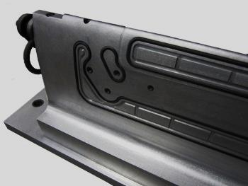
Vacuum Mill Fixtures

Slide 11
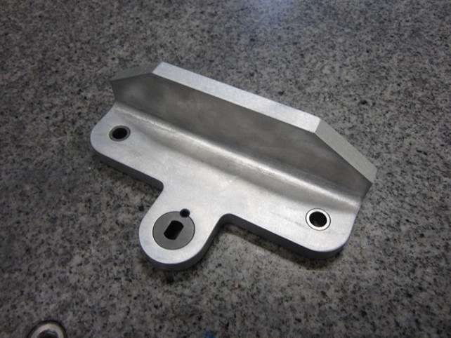
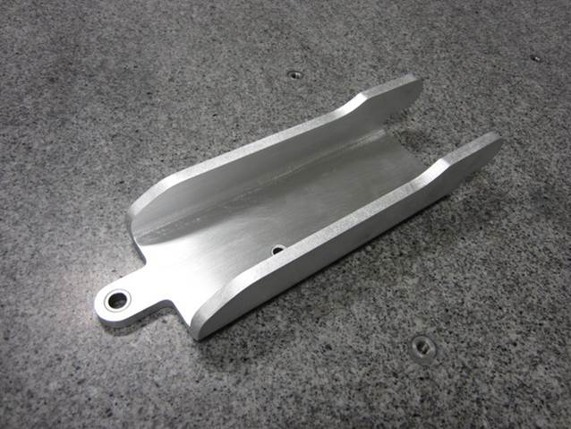
Trim Drill Fixtures

Slide 12
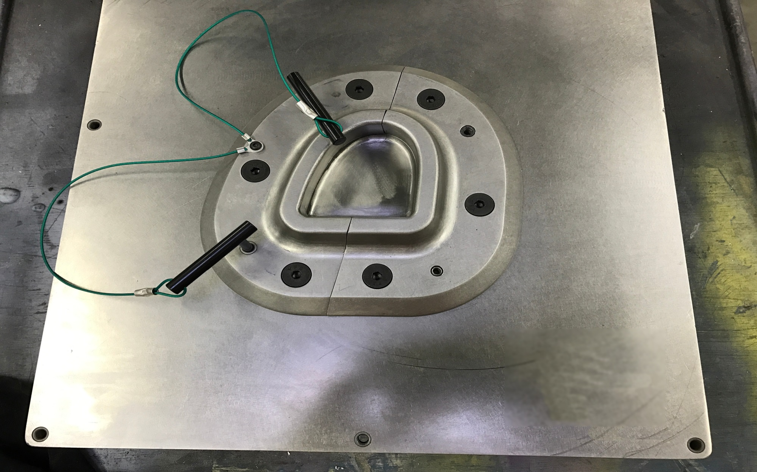
Bond Tools

Slide 13
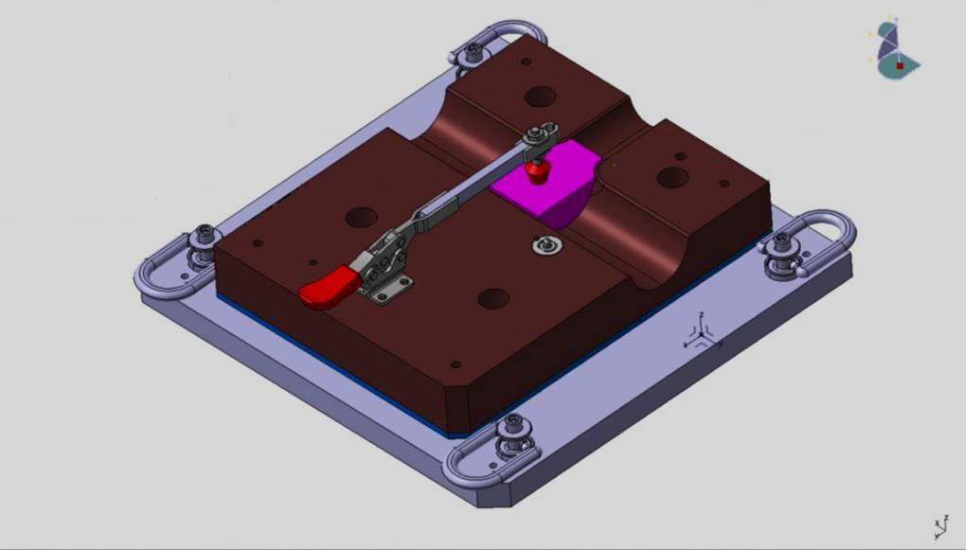
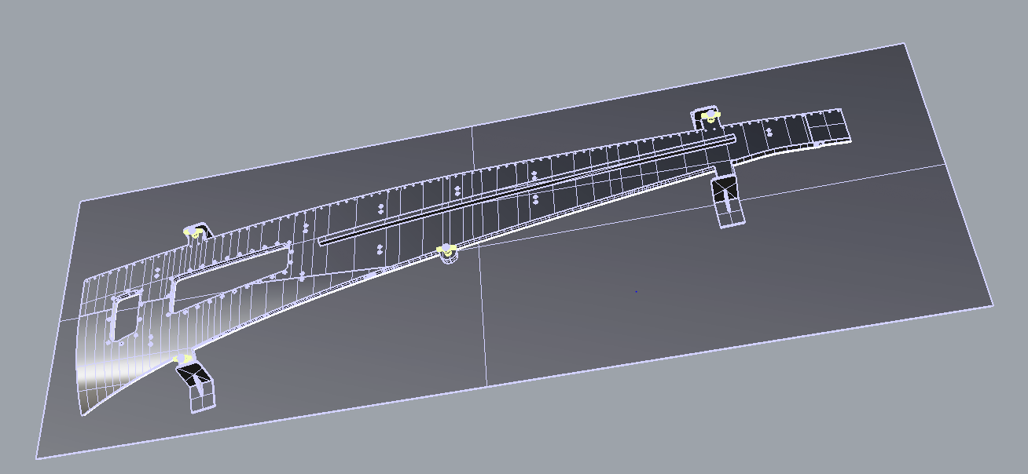
Assembly Tooling Design and Build

Slide 14
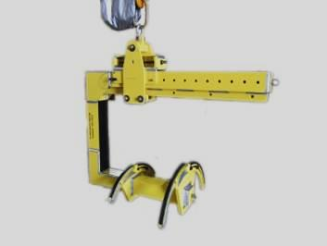
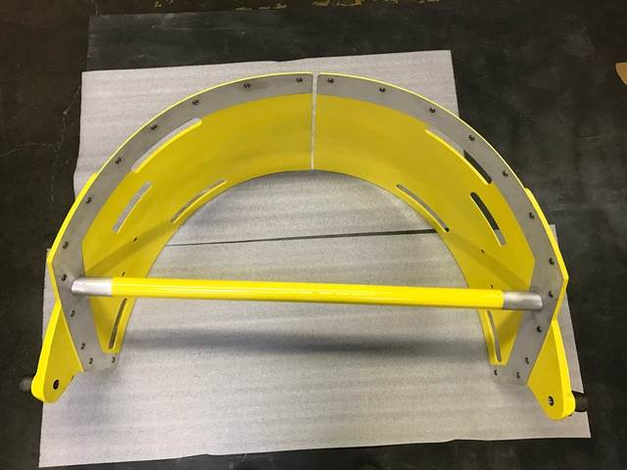
Overhead Moving Equipment

Slide 15
Complex Carbon Fiber Machining

Slide 16
Large Assembly Tooling

Slide 17
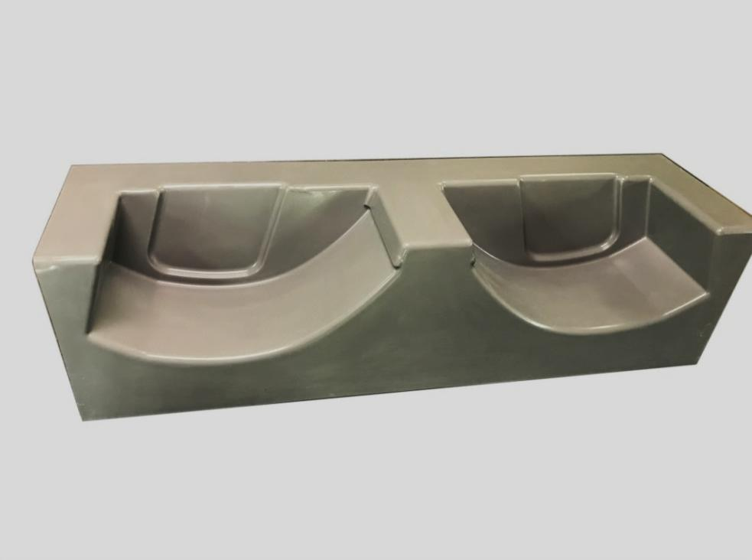
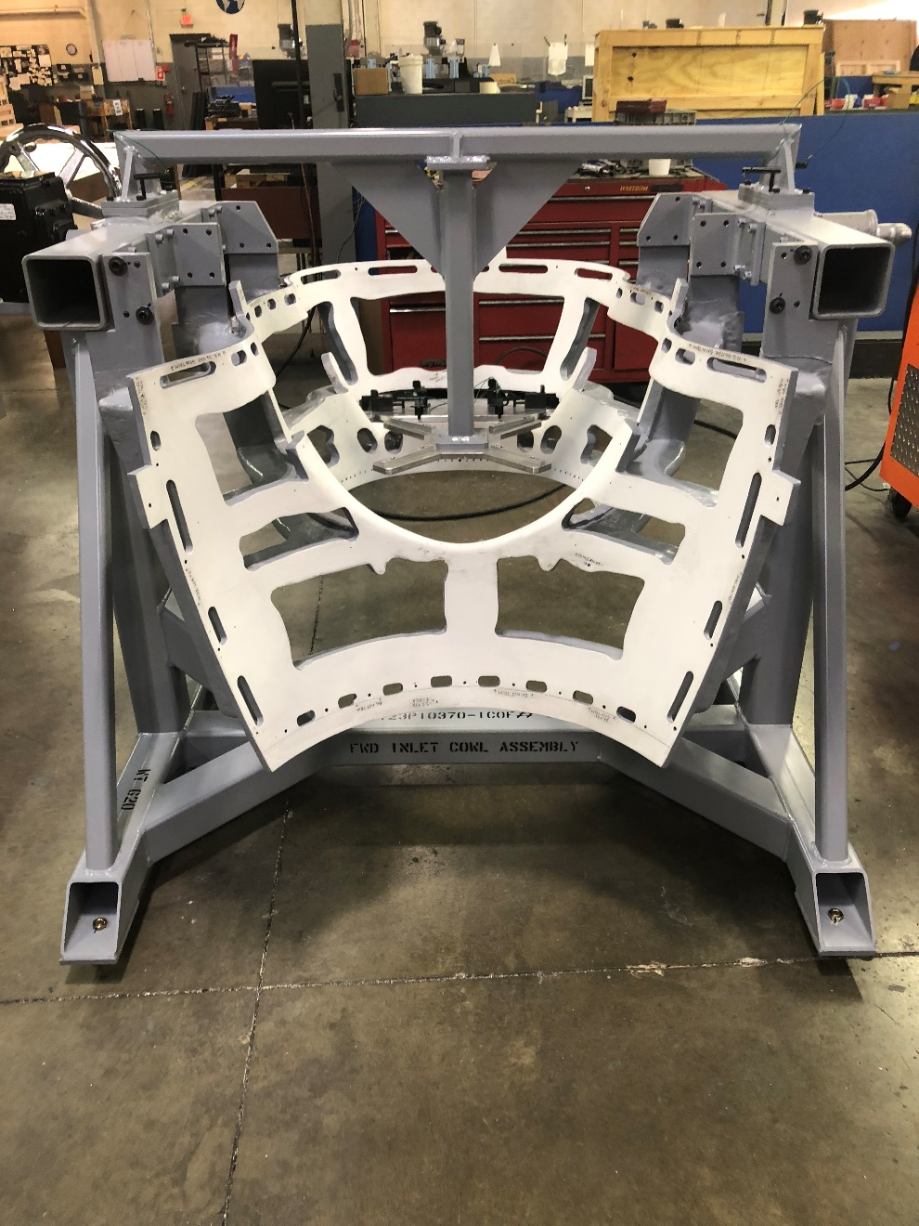
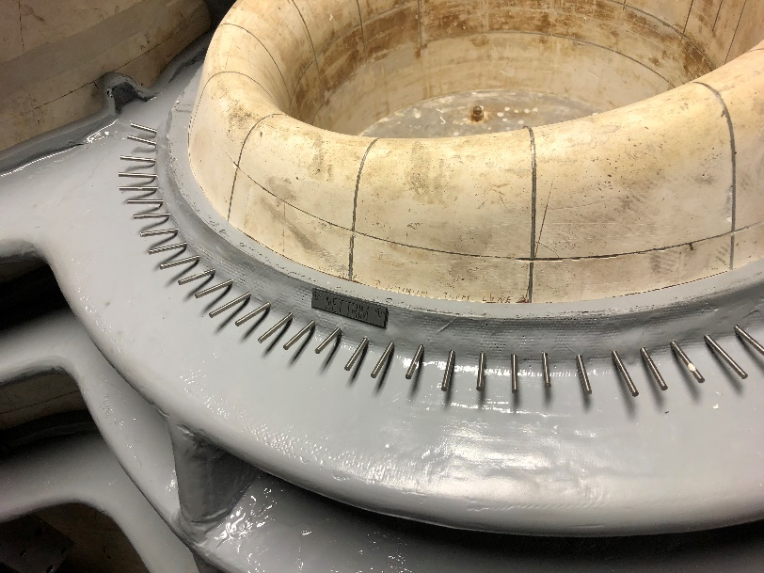
Soft Tooling

