Slide 1
Transtector Systems

Slide 2


Who We Are
Our Company: Infinite Electronics is a leading GLOBAL SUPPLIER of electronic components serving the urgent needs of engineers through a family of highly recognized and trusted brands, offering a wide portfolio of products ready to ship, and world-class technical support.
Our Vision: To be the FIRST answer to an engineer’s search for wired and wireless
product SOLUTIONS.
Our Brand Promise: To serve engineers’ URGENT needs for electronic components through same-day focused operations and unmatched technical support.

Slide 3













Family of Brands

Slide 4
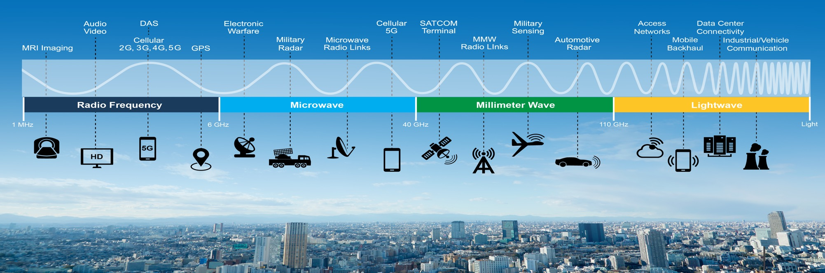
Our Products from DC to Light
, 5G

Slide 5
EMP | EMI | HEMP

Slide 6

What is EMP?
  EMP (Electromagnetic Pulse) is an intense burst of electromagnetic (EM) energy caused by an abrupt, rapid acceleration of charged particles.
  EMP Effects:
  A widespread collapse of the electric power grid could lead to cascading effects on our interdependent infrastructures, possibly lasting weeks or months.
  “Should the electrical power system be lost for any substantial period of time … the consequences are likely to be catastrophic … machines will stop; transportation and communication will be severely restricted; heating, cooling and lighting will cease; food and water supplies will be interrupted; and many people may die.”
  2008 EMP Commission

Slide 7
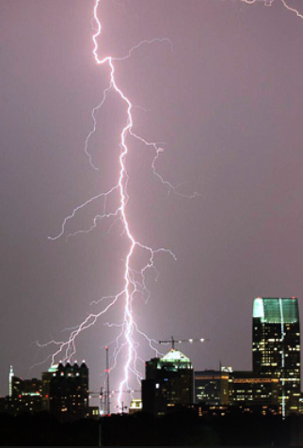


Types of EMP
Lightning EMP (LEMP)
High Altitude Nuclear EMP (HEMP)
Solar Flare (GMD)

Slide 8
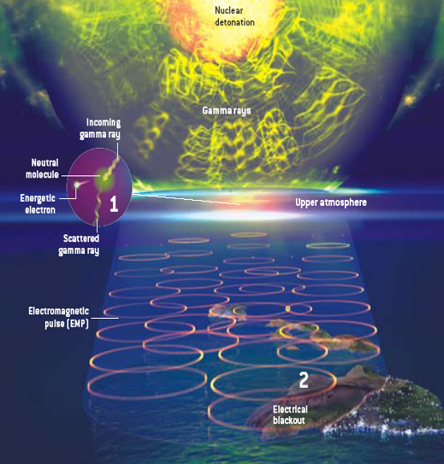

HEMP Explained

Slide 9
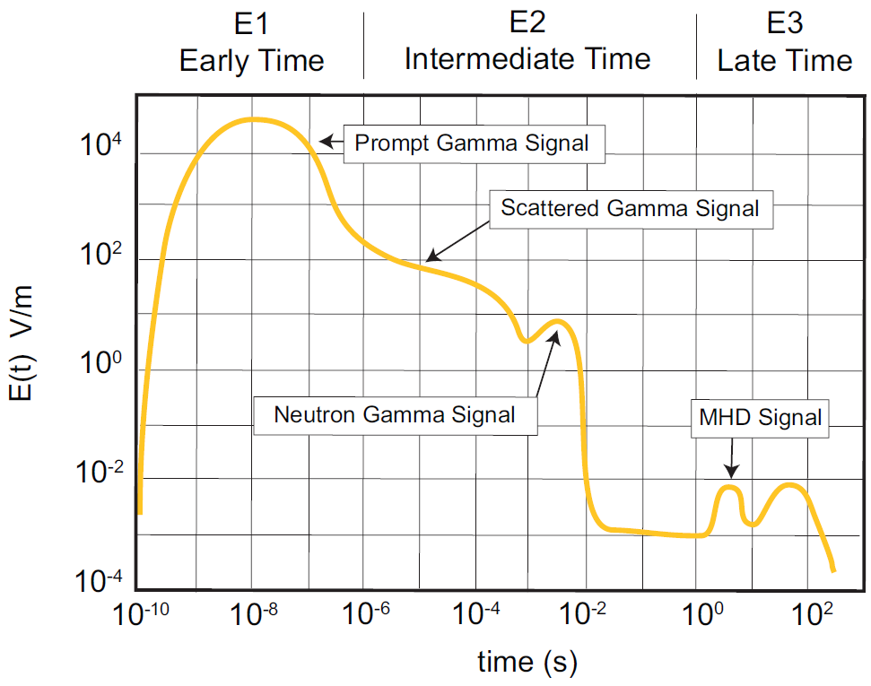
HEMP Triple Threat
3-Staged Waveforms from 1 Burst

Slide 10


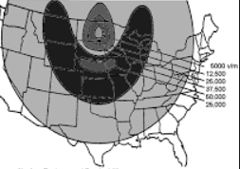
HEMP Waveforms – Impacts
The Early Time (E1) and Intermediate Time (E2) pulses pose a threat to local power and data networks
The Late Time (E3) pulse poses a threat for the continental power grid

Slide 11
EMP Experience
Custom Engineering and Manufacturing

Slide 12
EMP Customers
Military Bases & Government Facilities – Air Force and Army
  Patrick's, Peterson, Eglin, Edwards and MacDill Air Force Base
  Redstone & Fort Hood
  Pentagon
Military Agencies
  NASA, DOD, US Strategic Command, SPAWAR (Navy)
Defense Contractors
  Raytheon, Lockheed and Northrup Grumman – Various Locations (Missile Defense HEMP)
  Harris Rochester (HEMP), Melbourne & Palm bay (Ruggedized Power & Surge)
  SRC – AL (Mobile Vehicles – Surge and Ruggedized UPS)
  Zeta – VA (Ruggedized UPS)
  L-3 – Various offices (Surge Protection)
  L-3 – Connecticut NARD (Ruggedized Power)
  Lockheed - Various offices (RF Surge)
  Lockheed – PA (Ruggedized Power Systems)
  Gichner
  Ultra – Canada (Antennas)

Slide 13
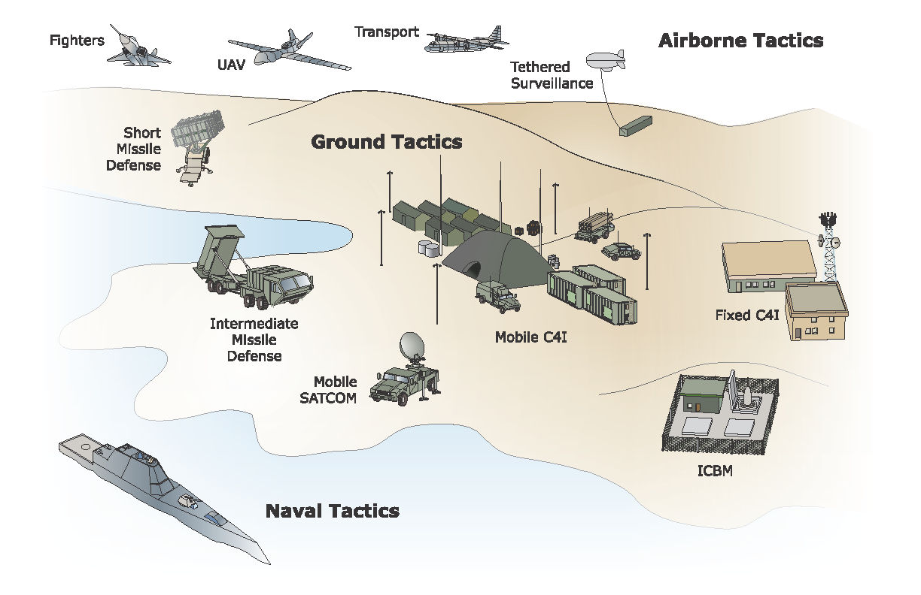
EMP Customers
Applications
  SatCom
  Missile Systems
  Mobile Vehicles
  Fixed Facilities
  Tent Cities
Military Programs
  SMART-T
  Patriot, THAAD, IBCS, JLENS
  Zumwalt
  Avior, CoachWhip

Slide 14
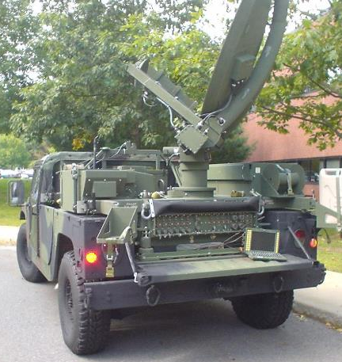
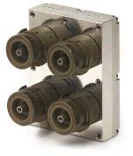
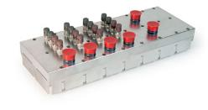
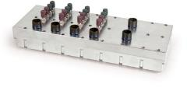
SMART-T
Smart Anti-Jam Reliable Tactical Terminal
US Army communications backbone to AEHF satellite

Slide 15
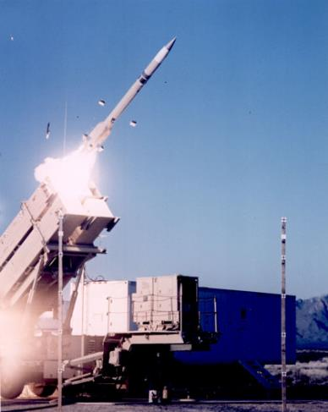
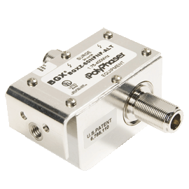
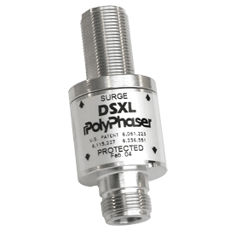
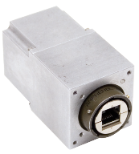
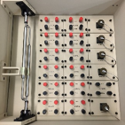
Patriot
MDA program for low altitude missile interception and destruction
16 FMS Countries
Upgrades GCFU
US Fleet Upgrades GCFU

Slide 16
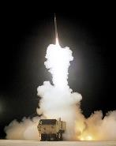
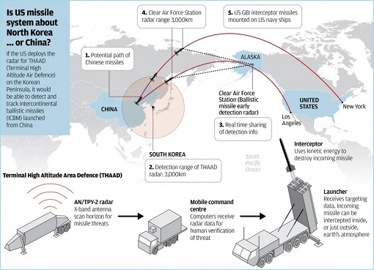
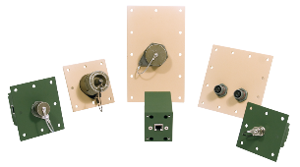
THAAD
Theater High Altitude Area Defense
MDA program for high altitude missile interception and destruction
Protecting all Communications lines on the Fire and Control
AN/TPY 2 Radar Interfaces with IBCS

Slide 17
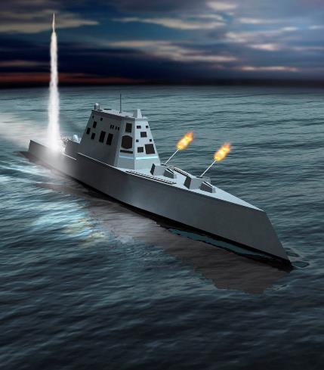
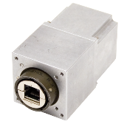
DDG 1000 Zumwalt
920 Ethernet HEMP filters
Radar, Control Lines, RF HEMP solutions

Slide 18
Ruggedized Power
Distribution Solutions

Slide 19
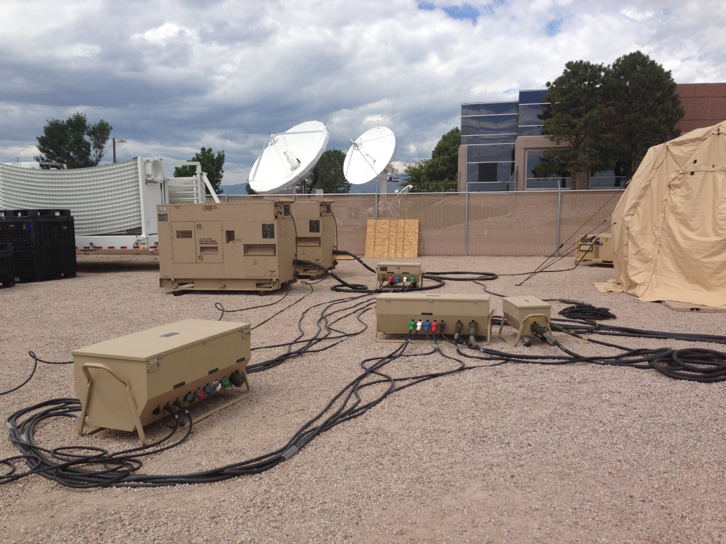
Ruggedized Power Systems

Slide 20
Product Overview
  Ruggedized Power Systems
  Two man or four man lift units
  Voltage - 120V-P, 120/240-SP, 120/208-3Y or 4160V
  Current - 60A to 2,000A
  Power – 15kW to Multi-Megawatt
  Class-L MIL-STD connectors
  Colors – FED-STD 595 (Tan and Green Lusterless)
    Chemical Agent Resistant coatings
  Integrated power quality solutions
    Surge Protection (Protects critical load equipment from transients)
    EMP/HEMP – Electromagnetic Pulse or High Electro Magnetic Pulse
  Environmental
    Rain, salt, fog, sand, icing and freezing rain
    Drop Test
    Shock resistant
  Temperature
    Operating Temperature range: - 25° F to +125° F
    Storage Temperature range: - 65° F to +150° F

Slide 21
Ruggedized Power System
  Power Generation
    Generators - 10kW to Multi-Megawatt
      Sound-Attenuation
      Mobile Units
  Paralleling Generators
    AGPU (Automatic Generator Paralleling Unit)
      10kW to Megawatt
      Multiple generators paralleled to connect to a common output bus
      Cycle generator based on a schedule to run periodically or on low fuel
    MGPU (Manuel Generator Paralleling Unit requires field personal)
      10kW to Megawatt
  Transfer
    ATS (Automatic Transfer Switch)
      Automatic - 30A to 2,000A
    MTS (Manuel Transfer Switch requires field personal)
      Manual - 30A to 2,000A

Slide 22
Ruggedized Power System
  Distribution
    SDC (Secondary Distribution Center)
      150kVA
      4160V to 120V
    PMU (Power Monitoring Unit)
      60A to 800A
      Monitors voltage and current
    PDU (Power Distribution Unit)
      60A to 800A
      15kW, 25kW, 30kW, 60kW, 1,000kW and 200kW
  Emergency Shut Off
    EPO (Emergency Power Off)
      Emergency power shout off cable with push button.
  Cables
    30A to 800A
    Pin-N-Sleeve, pigtails, Class L MIL-STD and Cam-Lok

Slide 23
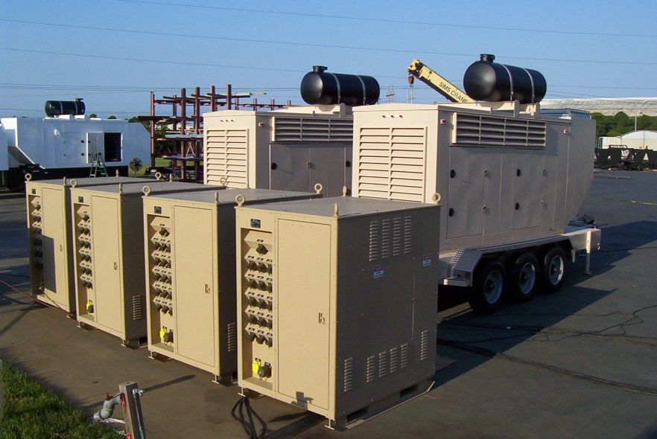
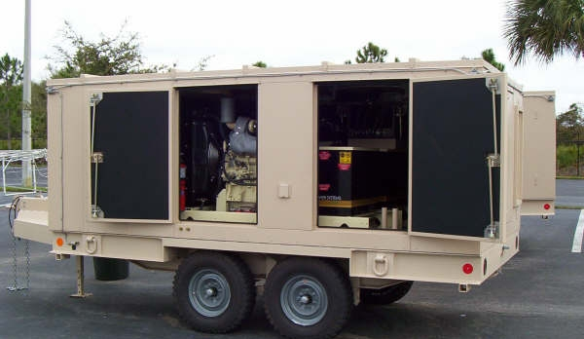
Ruggedized Power Generation

Slide 24
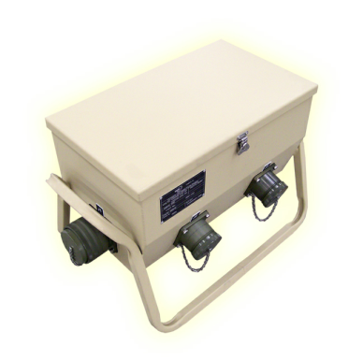
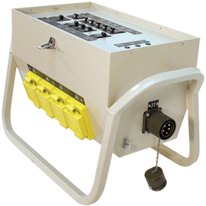
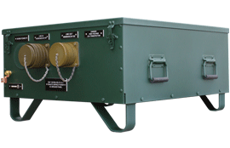
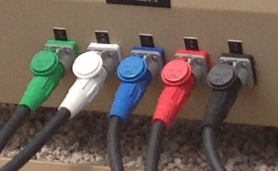
Power Distribution Unit (PDU)

Slide 25
EMP Surge Protection
COTS Solutions

Slide 26

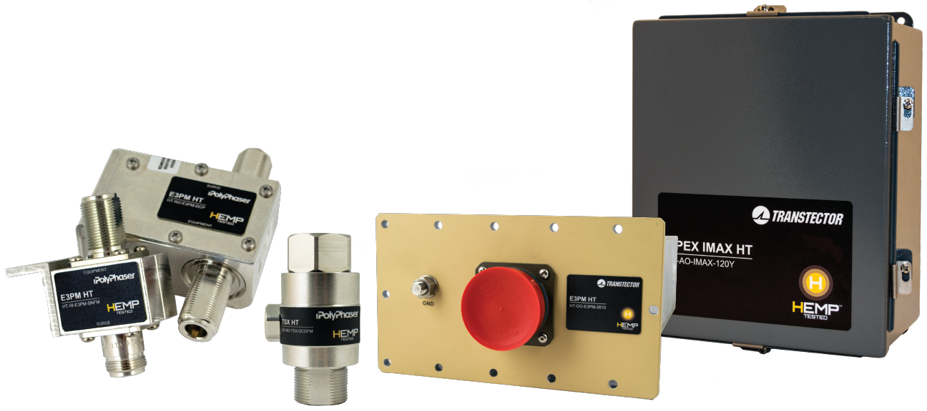
HEMP Tested
HEMP Tested products by Transtector are available for civil infrastructure applications including utilities, transportation, telecommunications, and first responders. Tested to stringent Military Standard 188-125 these products are engineered to provide EMP protection for equipment and facilities per Department of Homeland Security guidelines, and have been tested for survivability to the peak threat levels of the harsh Early Time (E1) and Intermediate Time (E2) High-Altitude (HEMP) environments.

Slide 27
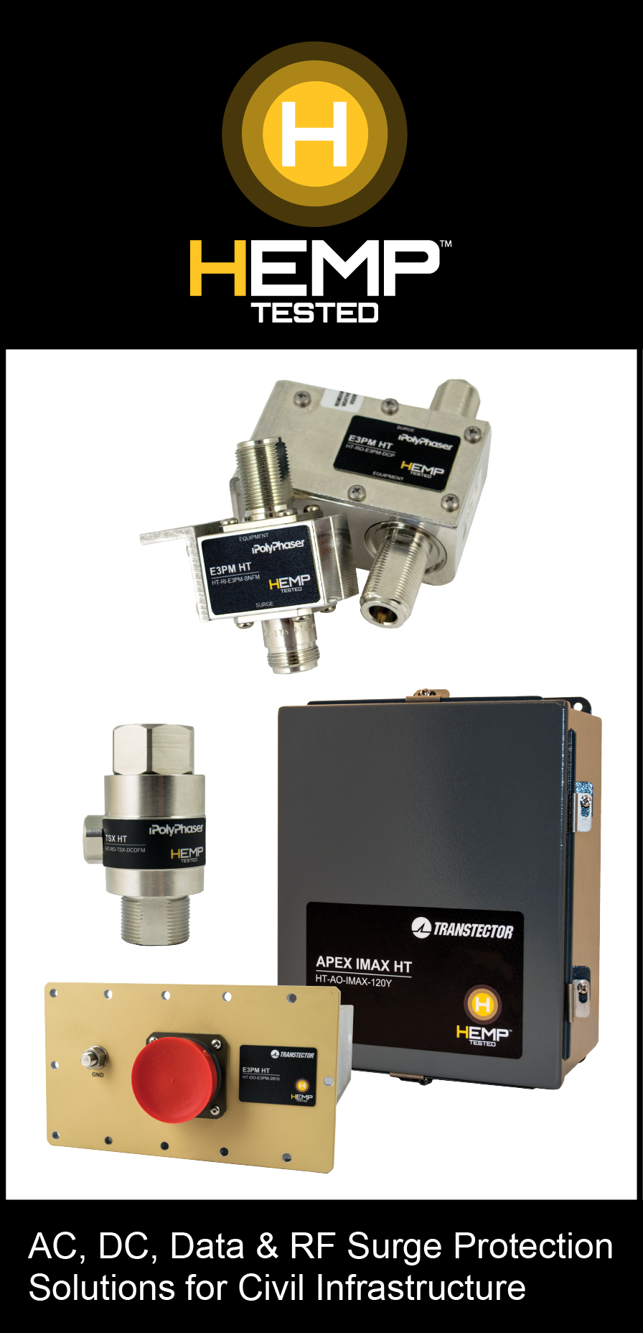
Value Proposition for EMP Surge Protection
Value Proposition: HEMPTested products safeguard connectivity critical to economic productivity, commercial stability, and national security.
Leading technology
Testing and certifications
Civil Infrastructure solutions
Experienced partner with Military, Governments and Prime Contractors

Slide 28
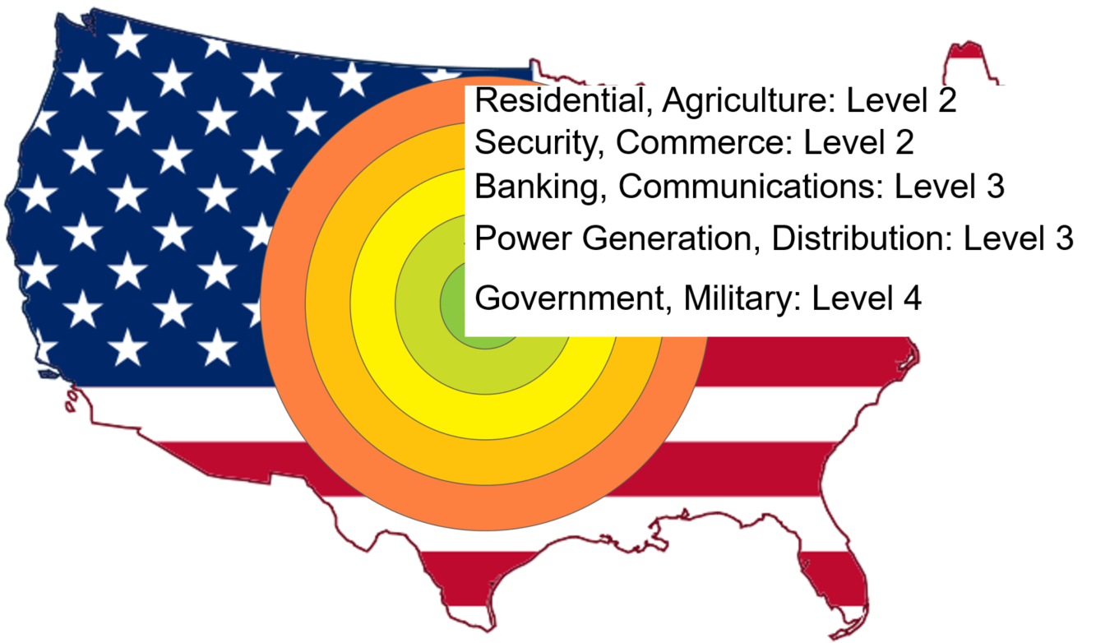
Application | Markets
Civil Infrastructure
Utilities
First Responders
Telecommunications
Banking & Finance
Security
Commerce
Agriculture
Residential

Slide 29
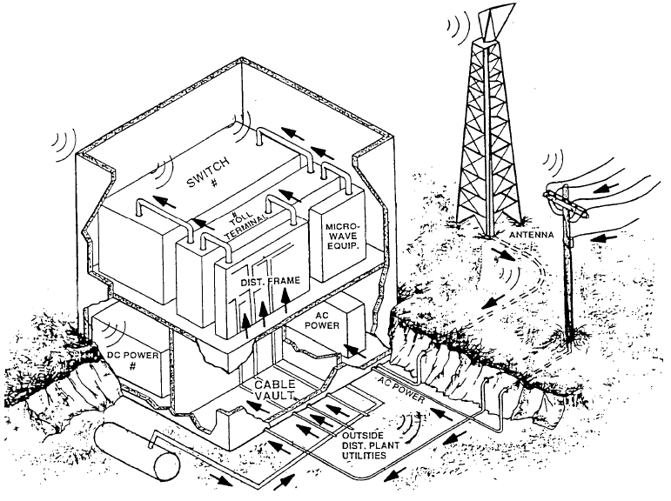


Systems Approach to HEMP/EMP Hardening

Slide 30
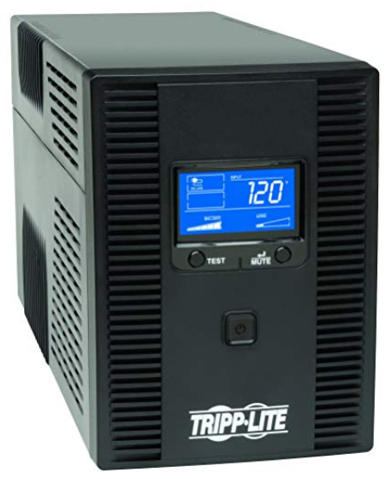
EMP System Solutions
Key elements to ensure system operability after an EMP event.
1. Transtector/PolyPhaser EMP rated surge protection devices
2. Implement backup power
systems, such as
uninterruptible power
supplies (UPS)
3. Bond all dead metal, such as equipment frames, cabinets, cable raceways, ladder racks, and earthquake reinforcements. Always maintain a single point to ground!

Slide 31
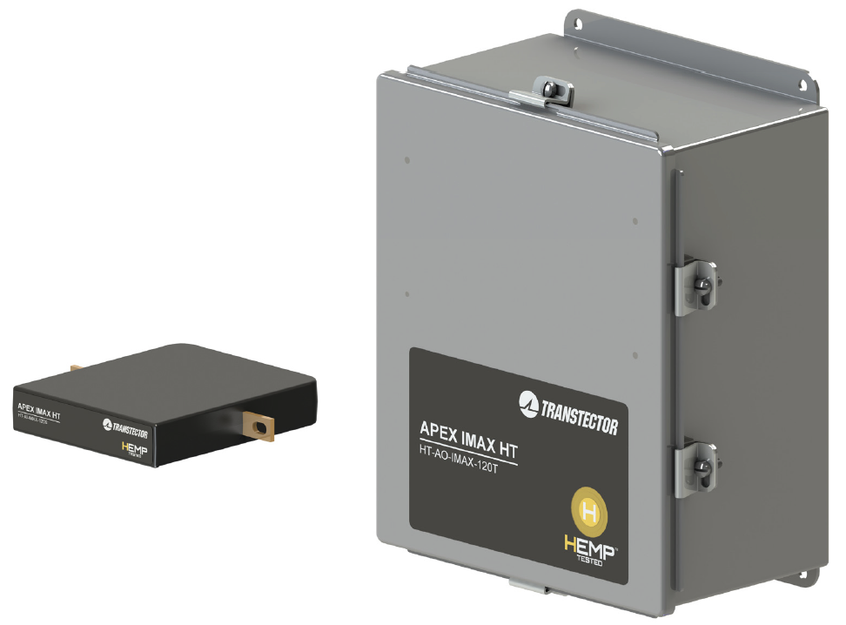
HEMP Tested APEX IMAX
Initial Offerings
HT-AO-IMAX-120T | 120/240 Vac Split-Phase
HT-AO-IMAX-120Y | 120/208 Vac Split-Phase
HT-AO-IMAX-120S | 120 Vac Single-Phase
Rated EMC enclosure provides
80 dB shielding effectiveness
System and standalone module tested to:
HEMP E1 Waveform
HEMP E2 Waveform

Slide 32
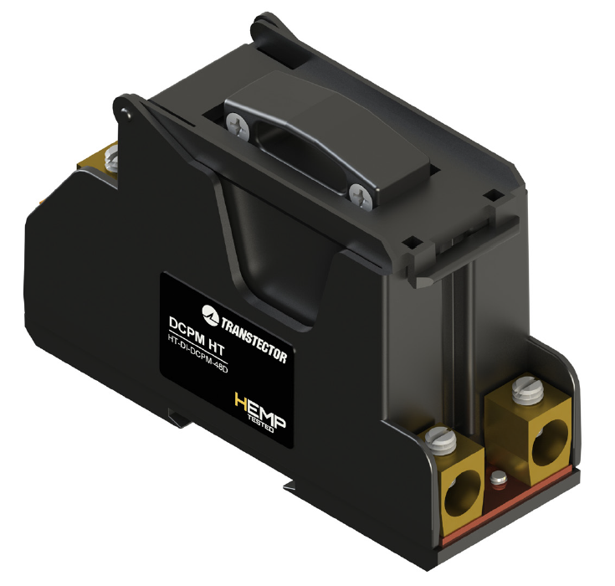
HEMP Tested DCPM
Initial Offerings
HT-DI-DCPM-48D | 24, 28, 48 Vdc Dual-Mode
Module Tested to:
HEMP E1 Waveform
HEMP E2 Waveform

Slide 33
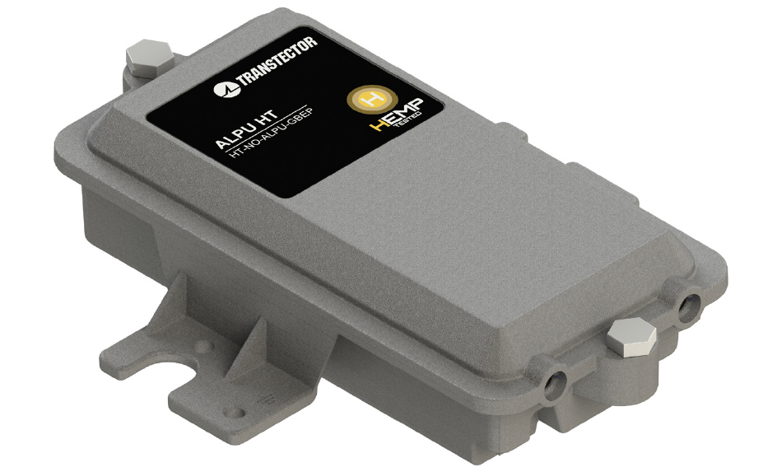
HEMP Tested ALPU
Initial Offering
HT-NO-ALPU-GBEP | Outdoor GbE/PoE++
EMI perimeter gasket provides enhanced shielding effectiveness
Product tested to:
HEMP E1 Waveform
HEMP E2 Waveform

Slide 34
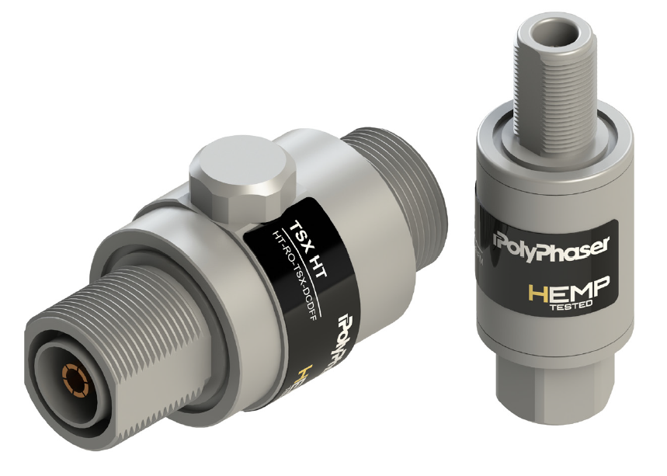
HEMP Tested TSX
Initial Offerings – GPS, Cell, LMR
HT-RO-TSX-DCDFF | DC Pass, ‘D’ F-F, 700MHz to 2.5GHz + AISG
HT-RO-TSX-DCDFM | DC Pass, ‘D’ F-M, 700MHz to 2.5GHz + AISG
HT-RO-TSX-BNFF | DC Block, ‘N’ F-F, 700MHz to 2.5GHz
HT-RO-TSX-BNFM | DC Block, ‘N’ F-F, 700MHz to 2.5GHz
HT-RO-TSX-BDFF | DC Block, ‘D’ F-F, 700MHz to 2.5GHz
HT-RO-TSX-BDFM | DC Block, ‘D’ F-M, 700MHz to 2.5GHz
Sealing and mounting gaskets provide enhanced shielding effectiveness
Tested to:
HEMP E1 Waveform
HEMP E2 Waveform

Slide 35
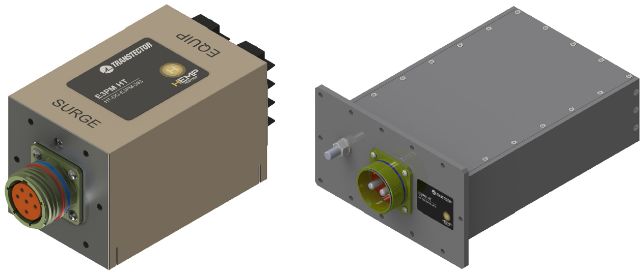
HEMP Tested E3PA & E3PM
AC, DC, Data/Signal, RF
Military Grade HEMP/EMP Protection
Integral EM barrier supports shielding effectiveness of system master shield
Multi-stage surge protection for extremely low output residuals
Designed for rugged military shock/vibration and environmental requirements

